Slide 1
Leveraging 3D Virtual Models for Enhancing Postpartum Mental Health and Relaxation
Team Members
1.Swetha J
2.Varsha Thomas
3.Varun SP
Supervisor: Dr. G Dharani Devi

Slide 2
Introduction
Postpartum depression (PPD) is a serious emotional and psychological condition that affects a large number of new mothers worldwide—often silently. The early months after childbirth, which should ideally be filled with joy and bonding, can instead become a time of anxiety, sadness, and emotional detachment. Unfortunately, the stigma around mental health, combined with lack of accessible support, means many women do not seek help. Traditional methods like medication or in-person therapy often aren’t viable due to breastfeeding concerns or the practical challenges of leaving home with a newborn. This is where our project steps in—leveraging emerging technologies like AR and VR to offer mothers a safe, accessible, and responsive form of emotional support that they can use from the comfort of their own homes.

Slide 3
Problem Statement
The core problem we aimed to address is the inaccessibility and impracticality of conventional postpartum depression treatments for many new mothers. Psychotherapy, while effective, demands time, transportation, and privacy—resources that are often scarce during early motherhood. On the other hand, antidepressant medications can introduce risks, particularly for mothers who are nursing. Furthermore, the emotional needs of new mothers are complex and change rapidly, yet most treatment methods fail to adapt in real time. Social stigma, geographic isolation, and lack of mental health awareness make it even harder for affected women to get the support they need. This creates a significant gap between what mothers need and what current systems provide—both emotionally and logistically.

Slide 4
STANFORD DESIGN THINKING MODEL
1)Empathize
Interviews with mothers revealed stress, isolation, guilt, and fear of judgment.
Clinician feedback showed gaps in postnatal mental care tools.
2)Define
To create a remote, user-adaptive mental wellness platform for mothers with PPD.
3)Ideate
AR/VR for emotional therapy, wearable sensors for biofeedback, interactive bonding modules.
4)Prototype
Developed a VR relaxation module and AR-guided maternal bonding scenes using Blender and ESP32 hardware.
5)Test
Positive feedback from early tests showed better emotional control and mother-child bonding experiences.

Slide 5
Features of the Project
Real-time emotion detection using Random Forest ML classifier.
VR environments that adapt lighting, audio, and visuals based on user’s emotional state.
AR modules for guided infant bonding and skill training.
Open-source, low-cost, scalable solution—ideal for rural health centers.
Modular design—can extend to other disorders like anxiety or PTSD.
Internet-enabled for remote support and clinical monitoring.

Slide 6
Pain points Identified
1) Clinical Challenges:
Long wait times and overburdened healthcare systems.
Lack of access to female mental health professionals in some regions.
2) Emotional Pain Points:
Feeling of detachment from the baby.
Emotional isolation and lack of peer support.
3) Practical Constraints:
Difficulty attending sessions due to baby care duties.
Fear of stigma from in-person therapy visits.
4) Tech Gaps:
Existing VR systems are static and not responsive to emotion or stress levels.

Slide 7
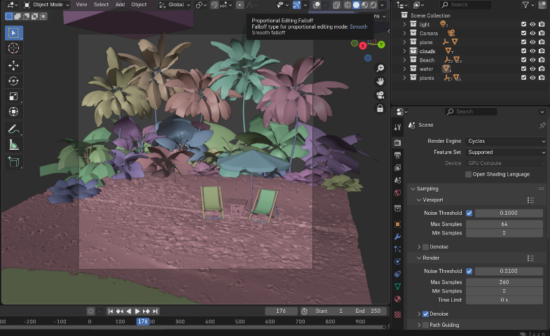
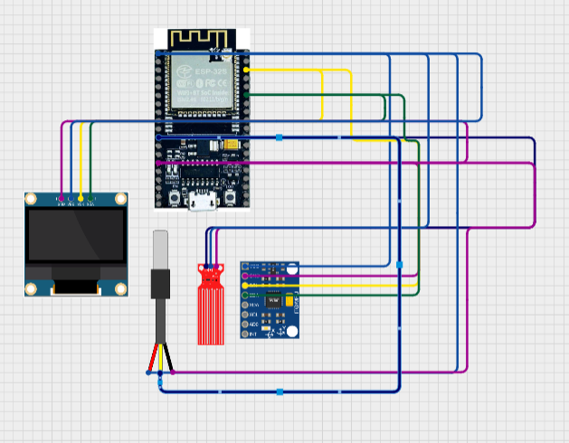
Technologies Used
Core Software:
Blender 4.0Real-time therapeutic environment creation.
Eevee rendering engine for smooth VR experience .
Adaptive design with color, light, and particle system changes.
Scene modifications based on PID-controlled feedback.
Other Tools:
Python for sensor data handling and communication.
Random Forest Classifier (Scikit-learn) for emotion detection.
Wired sensor interface with ESP32.
Internet transmission for remote clinical access.

Slide 8
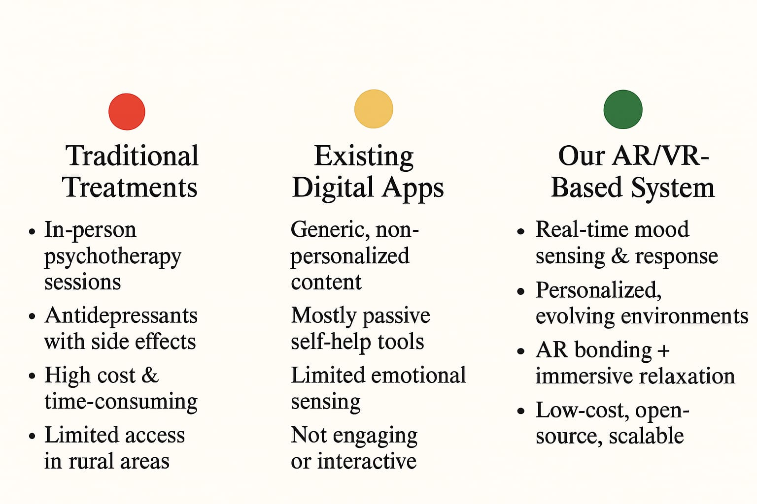
Comparative Analysis of Existing system

Slide 9
Proposed Method (Design Thinking Approach)
To develop a solution that truly meets the needs of mothers, we used the Stanford Design Thinking model. We started by empathizing—listening to new mothers share their emotional struggles and the obstacles they face in accessing help. These insights helped us define the core need: a private, accessible, and adaptive tool to manage postpartum emotional health. In the ideation phase, we explored the idea of immersive therapy using AR and VR, combined with wearable biosensors to monitor stress. We envisioned a platform where mothers could relax in personalized virtual environments or engage in AR-based bonding activities with their babies. We prototyped and refined these ideas using tools like Blender for 3D environments and conducted preliminary testing to ensure the system could adapt in real-time to a user’s emotional state. Our design thinking journey ensured that the technology was built around the user—not the other way around.

Slide 10
Proposed Method (Implementation / Prototype Developed)
Our prototype integrates both hardware and software components to create a responsive and immersive mental health support system. At the core is a wearable sensor unit powered by an ESP32 microcontroller, which collects real-time data on skin temperature, sweat levels, and body movement—key indicators of stress and emotional states. This data is processed through a Random Forest machine learning model that classifies the user’s emotional condition. Based on these readings, the system dynamically adjusts virtual environments developed in Blender 4.0, changing lighting, sound, and scene elements to match the user's mood. The AR modules support mother-infant bonding with guided interactive exercises, while the VR environments promote relaxation and mindfulness. All of this happens seamlessly, without requiring the mother to press buttons or navigate menus—offering a truly intuitive and supportive experience.

Slide 11
Target Audience Benefitted
This system is primarily designed for new mothers experiencing postpartum depression, especially those in environments where mental health care is stigmatized or hard to access—such as rural areas, low-income communities, or conservative cultural settings. It also benefits mothers who cannot leave their homes due to caregiving responsibilities or physical recovery. Beyond mothers, this solution can aid mental health professionals by offering them real-time patient data and progress insights, enabling remote and personalized support. Researchers studying maternal mental health can also gain valuable insights through anonymized data collection. Overall, the solution is inclusive, adaptable, and focused on giving mental health support to those who need it the most, when they need it the most.

Slide 12
Conclusion
Our AR/VR-based therapy platform offers a groundbreaking new way to approach postpartum mental health care. By combining real-time emotional monitoring with immersive, responsive digital environments, we’ve created a system that is both personal and powerful. It removes many of the barriers mothers face when seeking help—like stigma, logistics, and the clinical coldness of traditional therapy. This project isn't just about building technology; it's about reimagining how care can be delivered—empathetically, accessibly, and in a way that respects the emotional complexities of motherhood. We believe this work lays the foundation for a more compassionate digital future in mental health, especially for those who’ve felt invisible for far too long.

